Slide 1
Member Alert and Notification System
Michael Hyde
Northern Neck Electric Cooperative

Slide 2
Daily Usage eMail Notifications History
2007
Discussion with friend regarding daily usages
His “Self read” readings were entered into Excel
What if?
What if I could send the daily usage everyday via email?
Initially friends and employees
Then the Board

Slide 3
Daily Usage eMail Notifications Pilot
August 2007
Very Basic information
Provided reading
Calculated usage
Sent to:
All Employees
Board Members
Opened up to 250 Members

Slide 4
Daily Usage eMail Notifications Modifications
In addition to calculated usage:
Dollar value
Hi/low temp (Pulled using web-services)
Energy Tip (Random energy tip of the day)
News items
Uses:
Energy Conservation
Outage monitoring of seasonal Members

Slide 5
Hourly & Weekly Notifications
Graph of:
30 days prior usage
Hourly Usage
Graphical attachment

Slide 6
Hourly Usage eMail Notifications
Hour-by-hour usage
Pulled from TWACS
Energy Tip

Slide 7
High Usage eMail Notifications
eMail sent to member if their daily usage exceeds their set threshold.

Slide 8
Member Outage Notification Phase 2
Create scheduled job to ping subscribed members
How often?
Where to store the results?
Scheduled job or Run-as-service?
Have to check sub-status
Suspend during “Major Storm?”
Parameters to create an outage ticket?

Slide 9
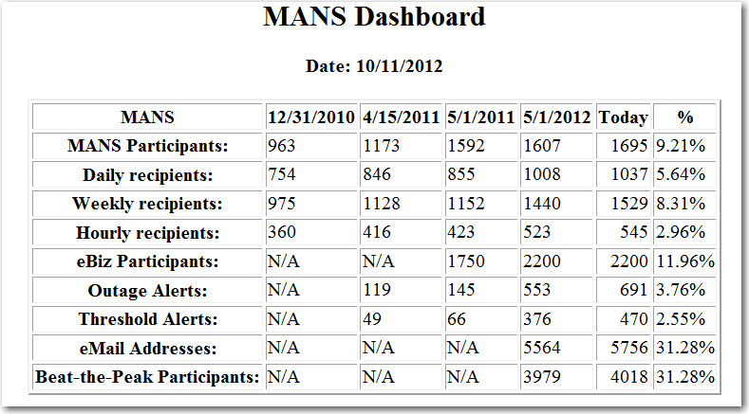
MANS Participation
“If you cannot measure it,
you cannot improve it.”
-- Lord Kelvin

Slide 10

What's in the Future?
Zero usage notification
Add Text Capability
App (iPhone, iPad, Droid)
Comparative Usage
Demand Response
Beat-the-Peak
Smart Home
Trend Analysis
MultiSpeak
Ability to set markers Usage comments by members)
Expand Comparison (2 years)

